Slide 1
THE EQUILIBRIUM
By Group 10:
Aman Urfi
Divya Gupta
Prithvi Reddy Navulla
Rajat Shanker

Slide 2

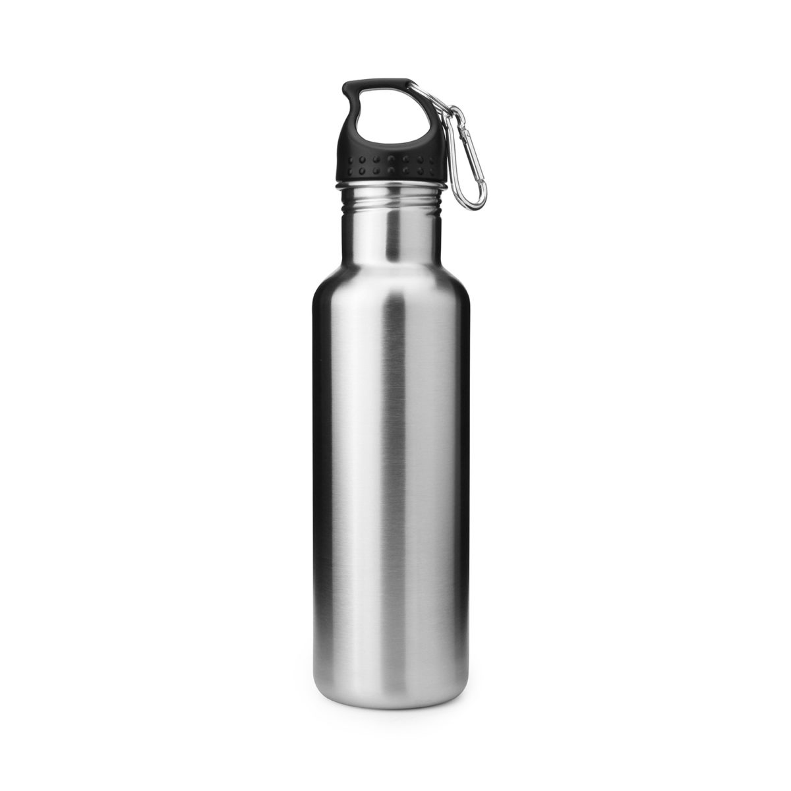
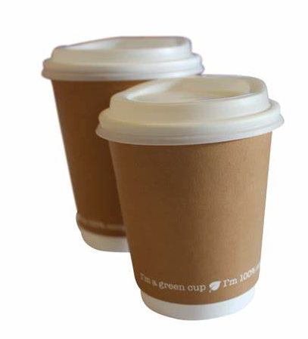
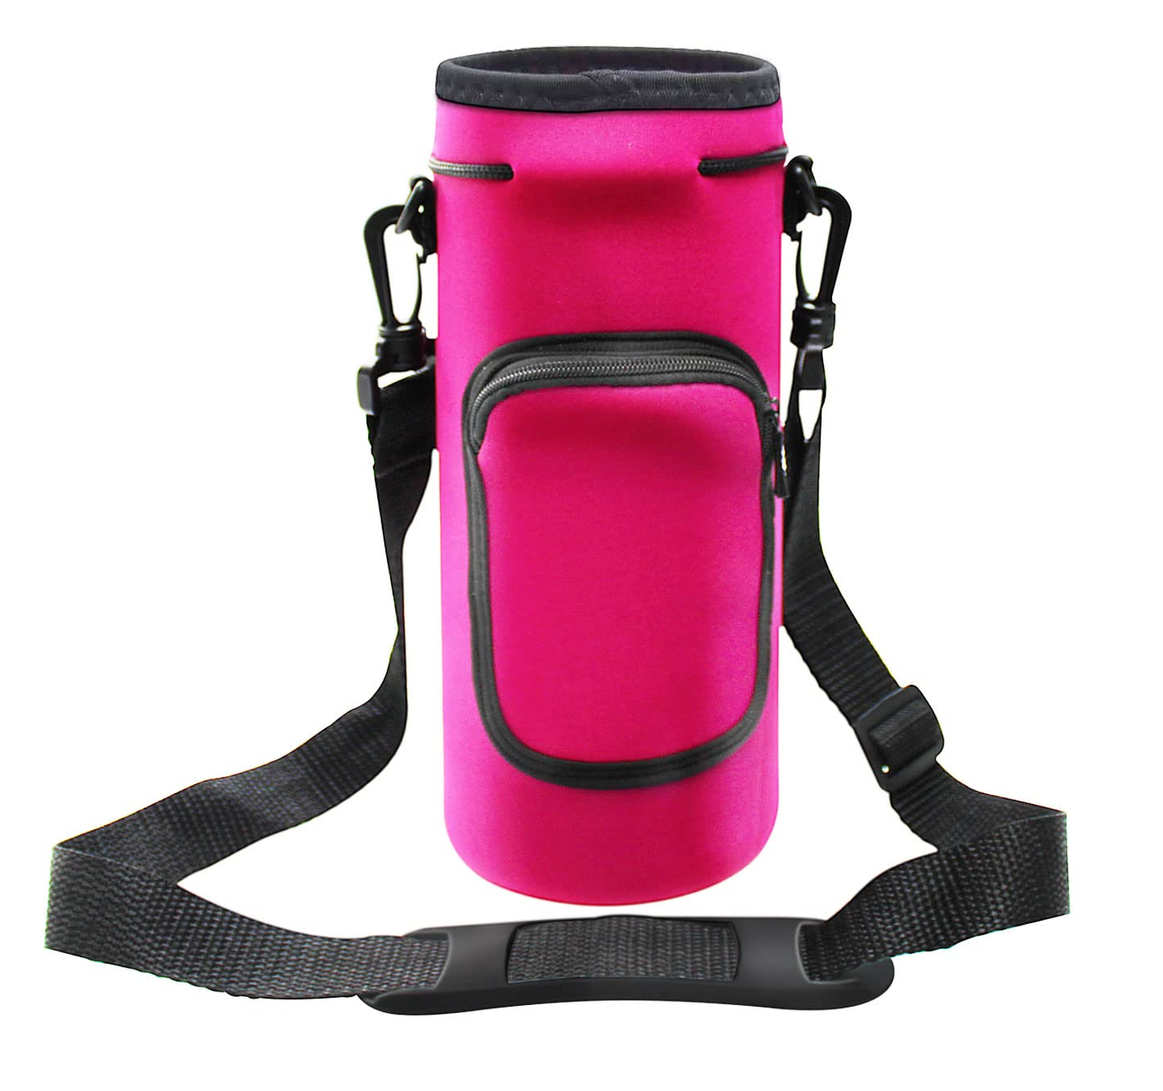
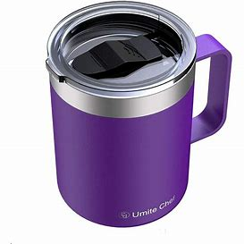
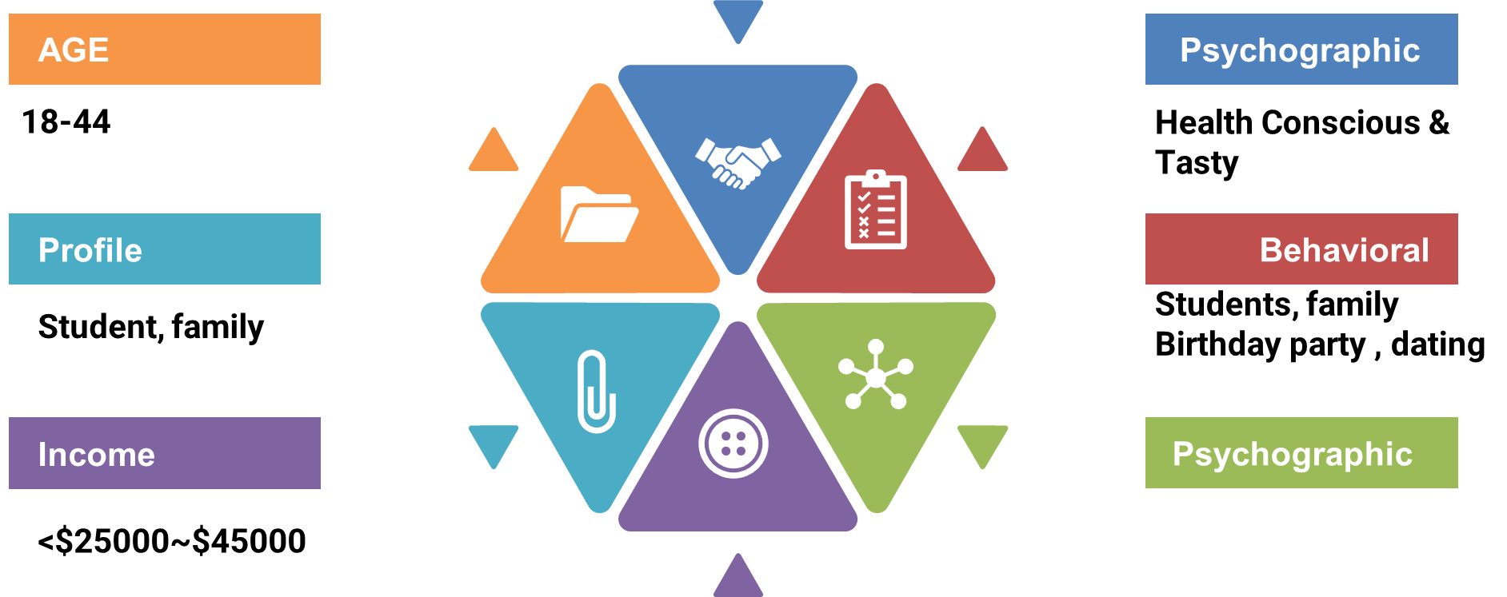





Opportunity Identification: Customer, Category, competition
Carry Two Flask/bottle
Single Use glass
Insulated Bags
Seeking Convenience & Eco Conscious
18-55
Student Working professional, Active person
Student/Office
Gym/Sports
Hiking/Picnic
Travelling

Slide 3

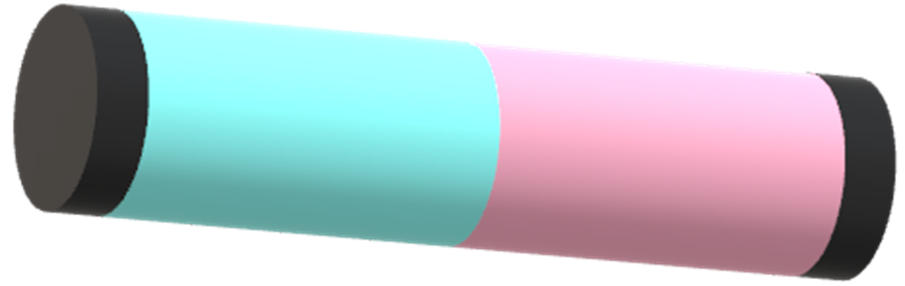
Introduction to product: describe concept.
Double the Convenience, Double the Hydration: Introducing the effortless "Equilibrium"
"The Equilibrium" is a revolutionary dual-compartment flask.
Keep your hot and cold beverages at their perfect temperatures all day long.
Two separate, insulated compartments, allowing you to carry both coffee and water, tea and iced tea, or any other hot and cold beverage combination you crave.

Slide 4
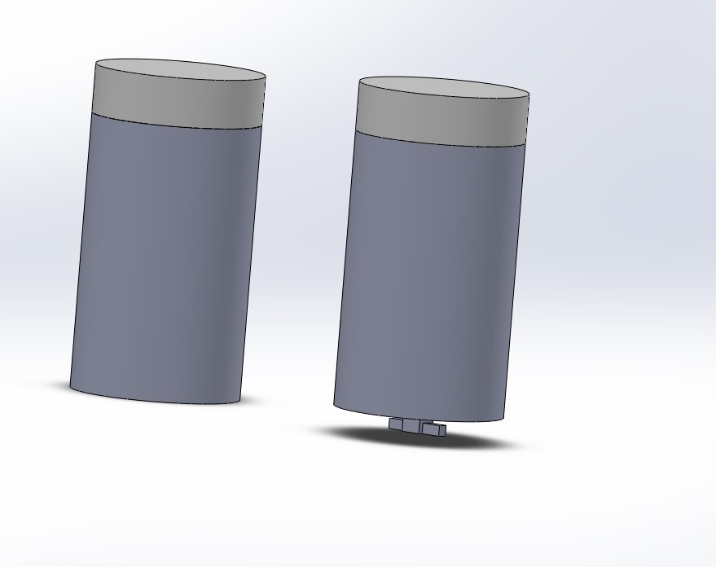
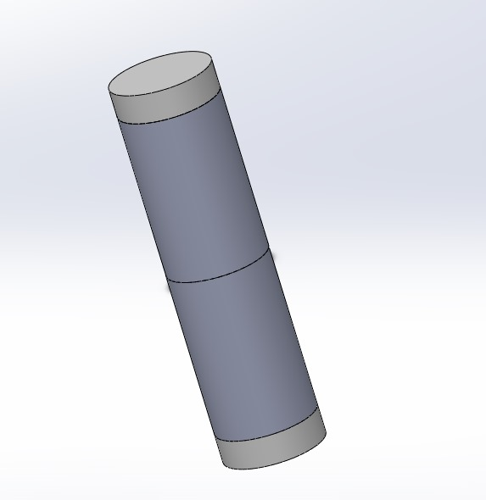
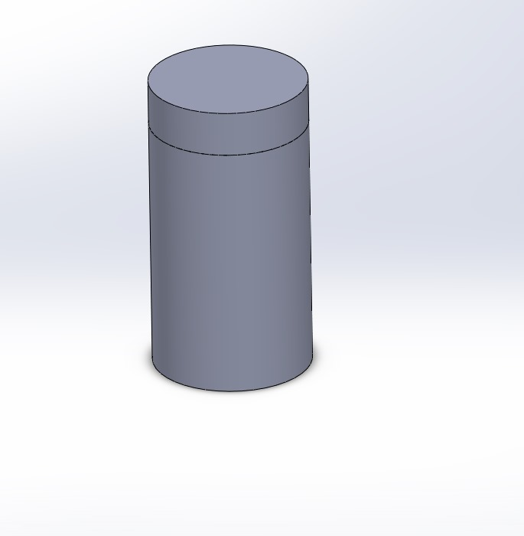
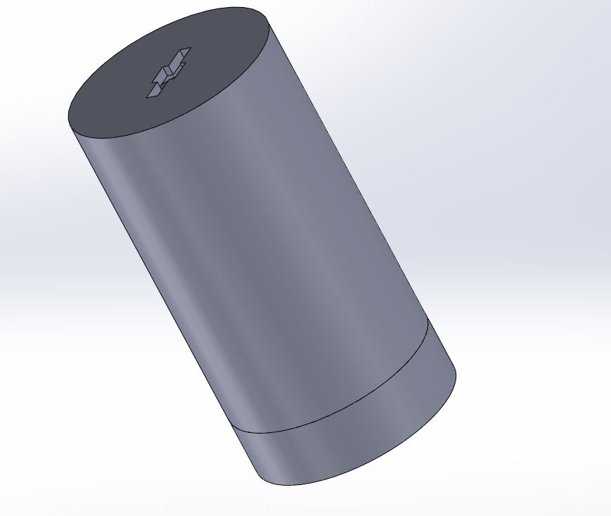
3D Prototype

Slide 5
Value Proposition

Slide 6
FUNCTIONAL BENEFITS
EMOTIONAL BENEFITS
Dual-Compartment Design
Independent Temperature Control
Convenience and Portability
Sense of Preparedness
Sense of Pride
Peace of Mind

Slide 7
POSITIONING STATEMENT
Equilibrium is the ideal dual-compartment flask for dynamic, environmentally conscious consumers who prioritize practicality and style. Unlike traditional flasks, it lets you effortlessly carry both hot and cold beverages in a single, stylish, leak-proof, and eco-friendly container. Designed for busy professionals, outdoor enthusiasts, and students, Equilibrium offers advanced temperature control to keep your drinks perfect all day. With its superior technology and design, Equilibrium ensures you stay hydrated and content, enhancing your active lifestyle wherever you go.

Slide 8
Potential barriers to adoption

Slide 9
Characteristics that Enhance adoption
Relative Advantage
Compatibility
Observability
Trialability

Slide 10

Product features:
Dual compartment and stackable design
24 Hour temperature retention
Leak proof seals
Durable and light weight material
Relative Advantage
Impact: Appeals to students and professionals engaged in daily routines such as commuting, working in offices or attending school, and participating in outdoor activities.
Survey Insights:
Dual Compartment
62.8% Find important, with 42.8% rating it as very important.
Stackable Design:
58% consider important, with 35% Rating it as Very Important.
24 hr. Temperature Retention:
78% consider important, with 40% considering it very important.
Leak-Proof Seal:
74.2% prioritize having leak-proof seals.
Lightweight and durable
77% find it important with 46% as very important.
Net Promoter Score:
The product achieved a Net Promoter Score of 50.
Demographic Appeal:
58% of college students and 33% of office professionals find the product appealing, primarily for outdoor activities (75%), commuting (64%), and office/school use (75%).

Slide 11
Characteristics that Hinders adoption
Complexity
Riskiness

Slide 12

Complexity
Perceived Customer Challenges:
Might feel complex design i.e., stacking
Handling dual compartments
Cleaning and maintenance
Risks associated:
Deviation for simple solutions
Flavour cross contamination concerns
Cleaning concerns
Mitigation strategy – Awareness
Demonstrate user friendly design
Instructions through documents and videos
Trialability
Demonstrate ease of cleaning and maintenance
Survey Insights:
Dishwasher safe:
60% consider it important, with 29% viewing it as very important.

Slide 13
Marketing Mix

Slide 14
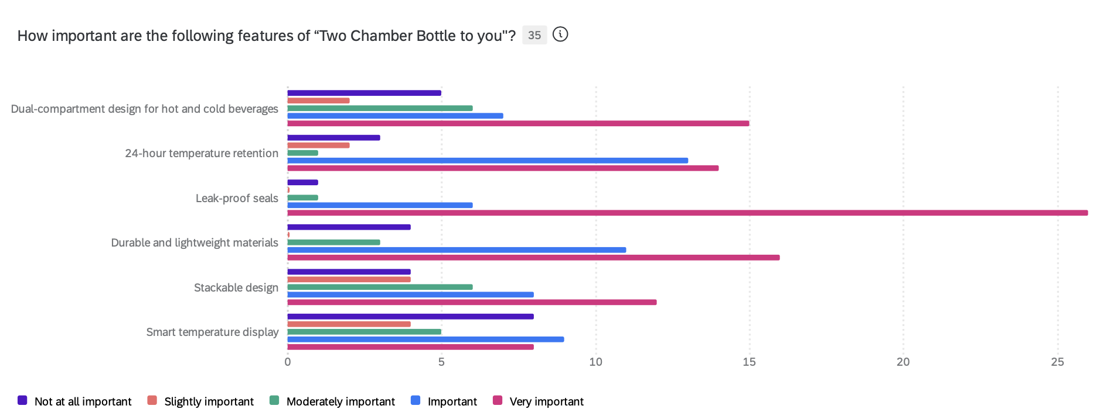
Product
Differentiating Features:
Dual-compartment design
Long temperature Retention
Stackable Design

Slide 15
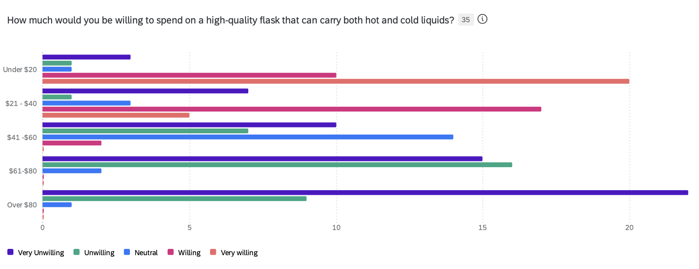
Price
Pricing Strategy – Price Skimming
High early price – $39.99
Gradually reduce the price

Slide 16
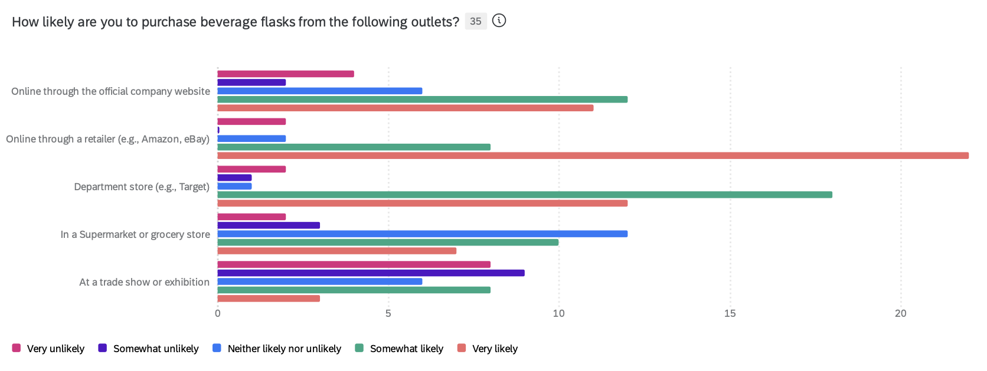
Place
Online:
Amazon, Ebay
Company Website
Offline:
Supermarkets – Target & Walmart

Slide 17
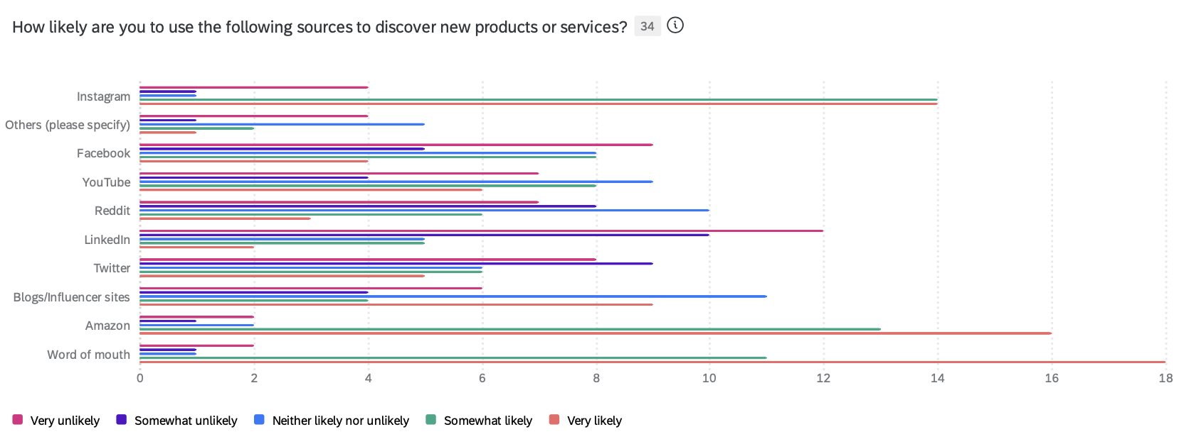
Promotion
Online:
Social Media: Instagram, Facebook, Youtube
Offline:
Coupons and Discounts at Target & Walmart

Slide 18
Financials
Materials
High-quality, Eco-friendly Materials: range from $5 to $10
Manufacturing
Labor and Manufacturing Overhead: range of $10 to $15 per unit
Research and Development
Initial R&D Costs: $50,000 and $60,000,
Marketing and Sales
Marketing Campaigns: range from $20,000 to $30,000
Distribution
Logistics and Distribution Costs: $2 to $5 per unit.
Suggested Retail Price
Pricing Strategy: With a production cost of $15 to $25, a retail price could be set at approximately $40

Slide 19

THANK YOU

